Slide 1

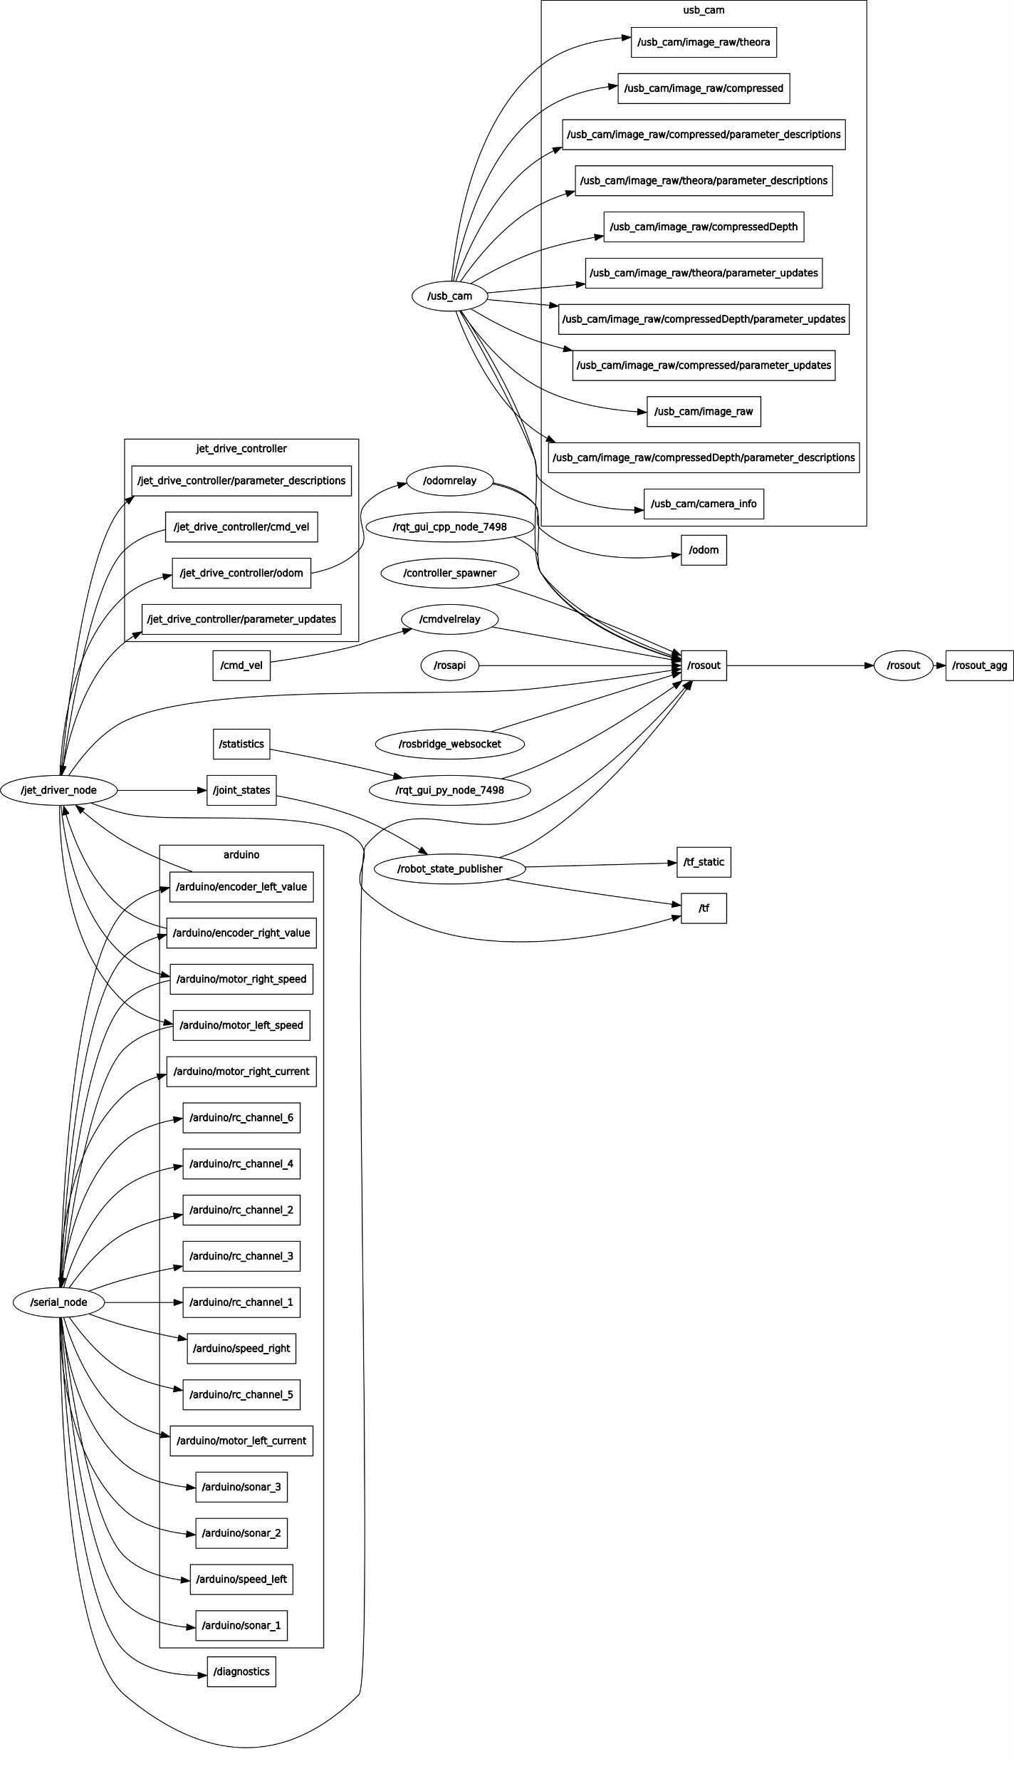
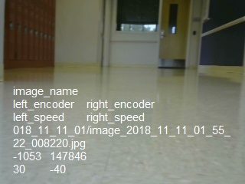
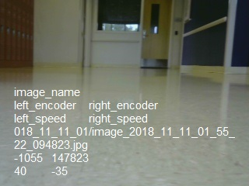
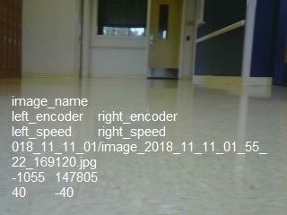
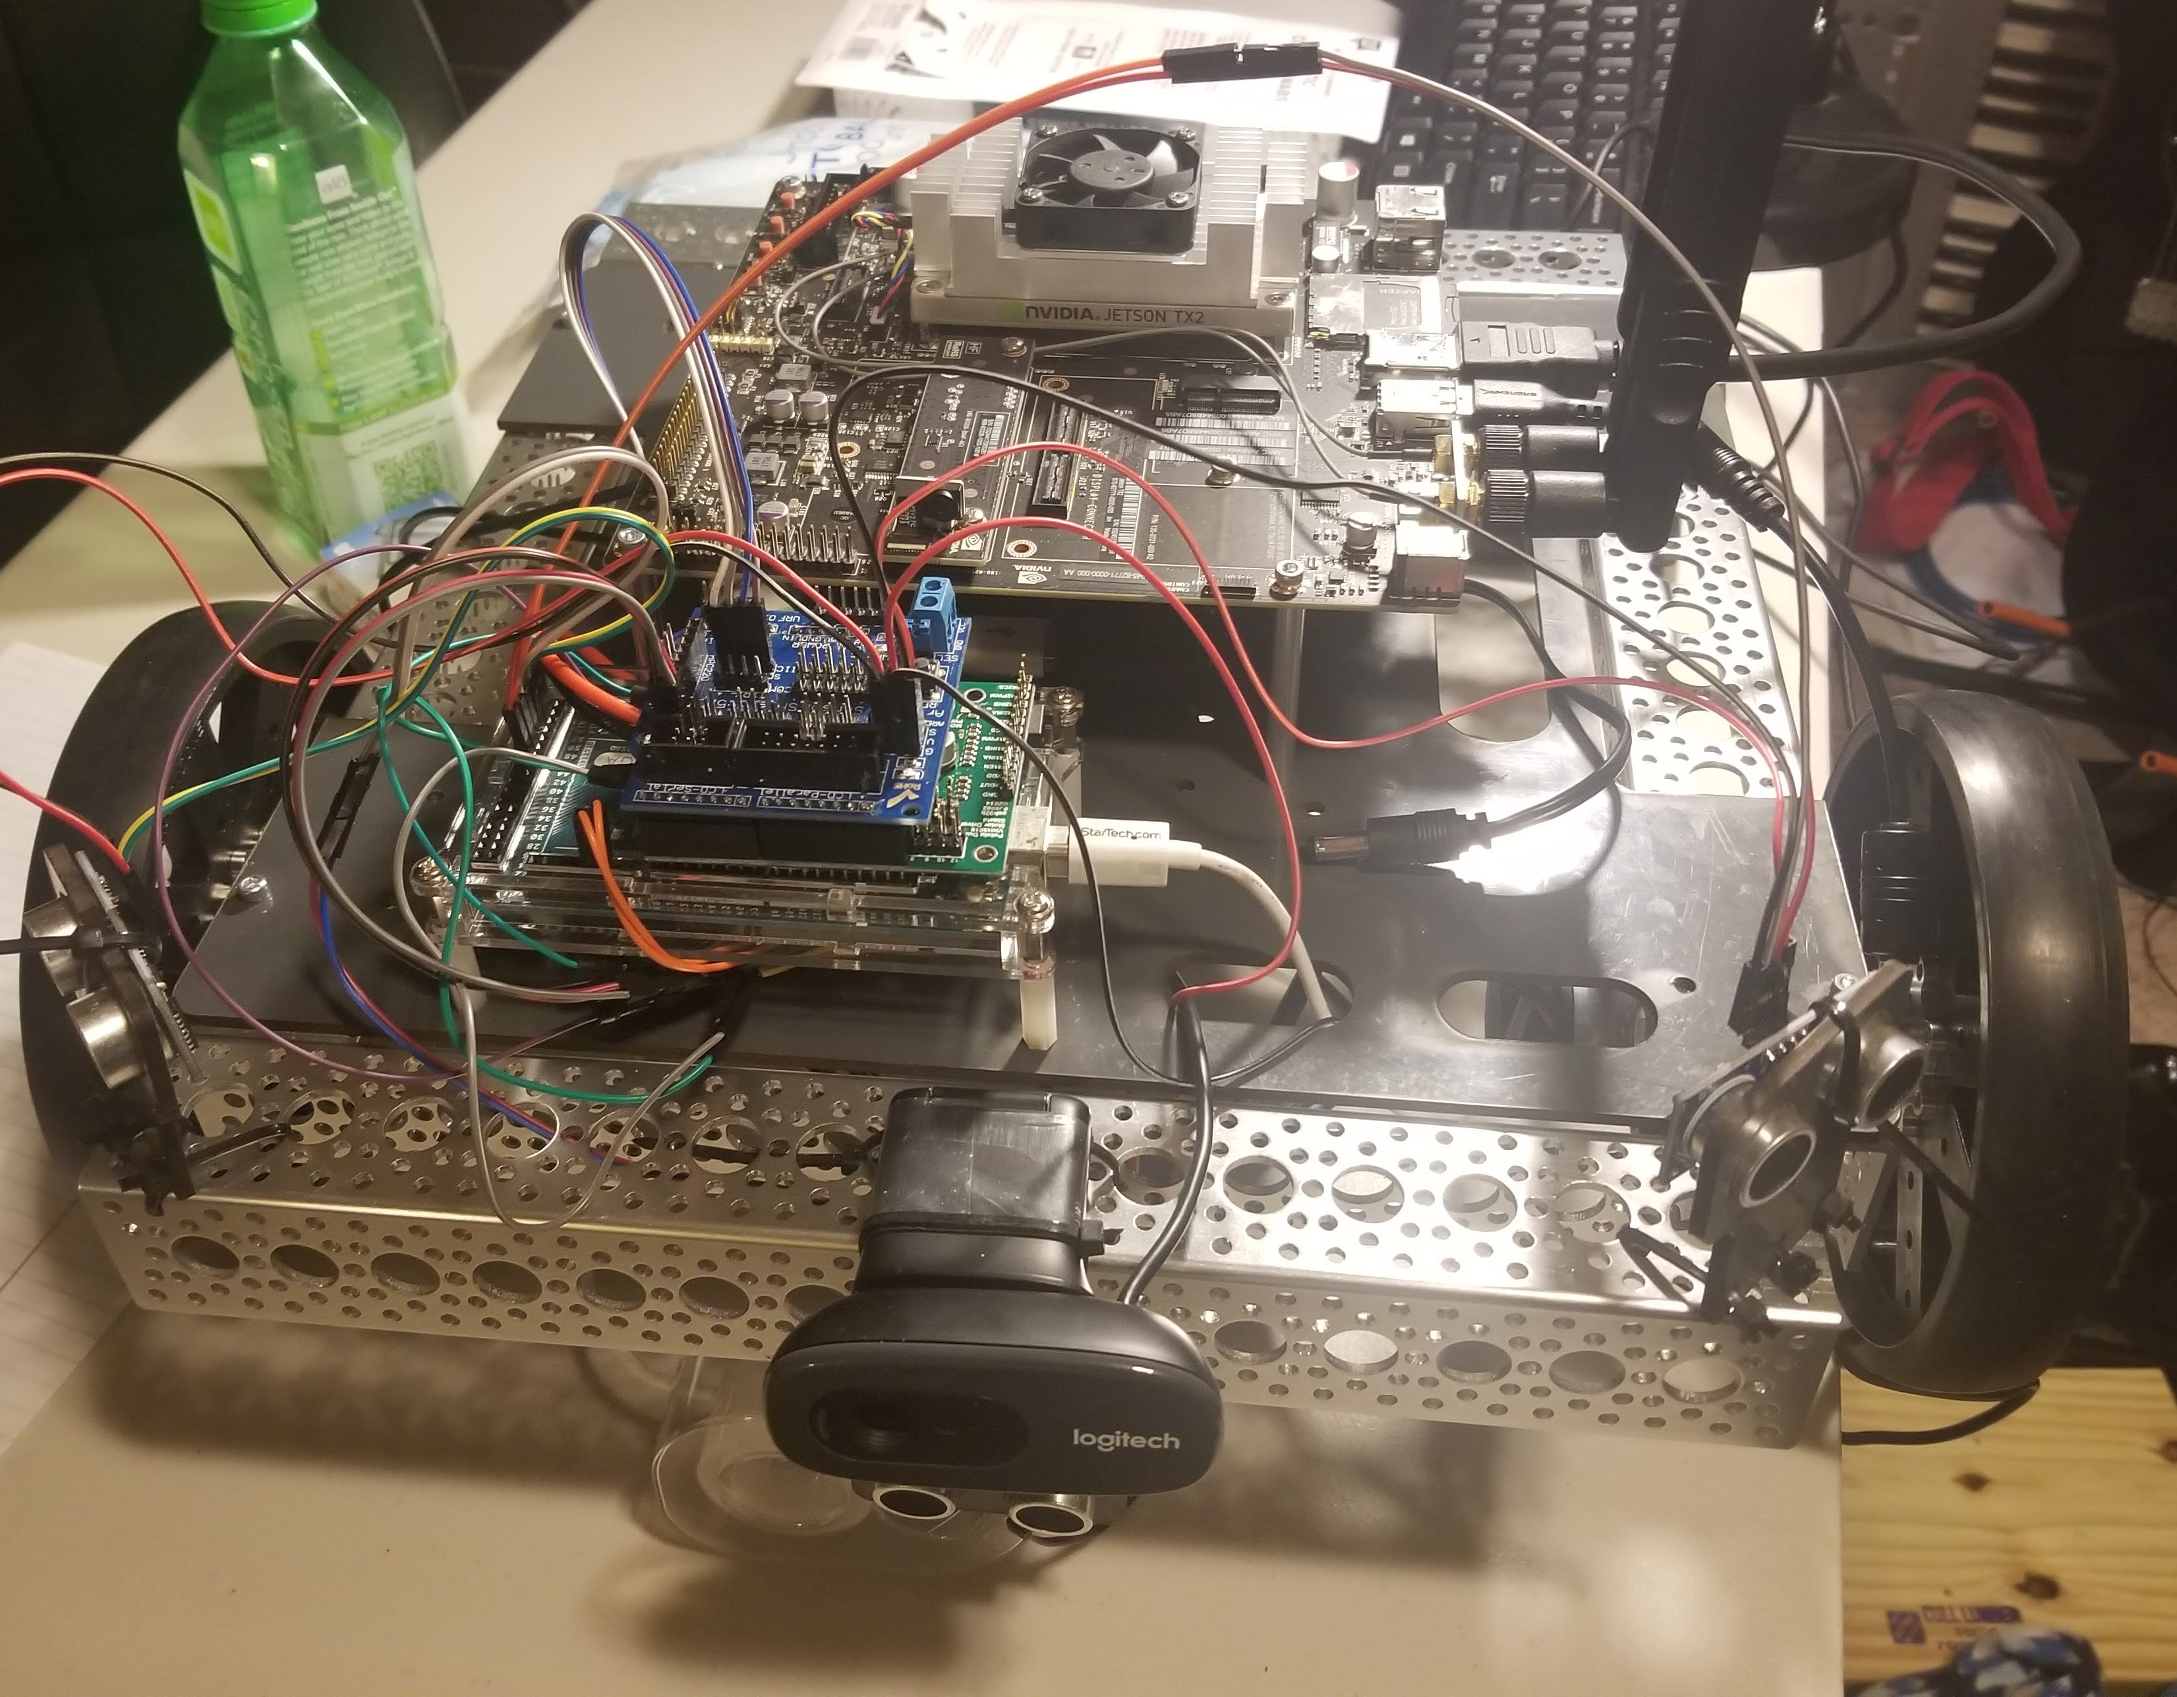
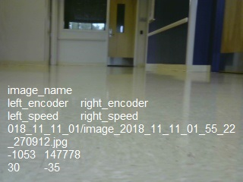
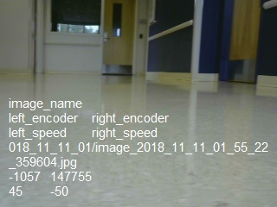
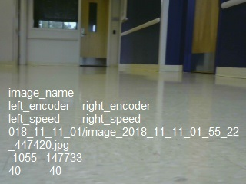
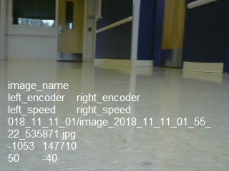
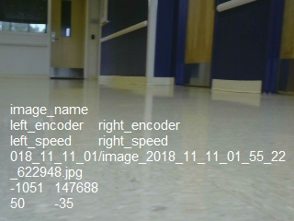
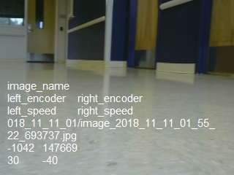
Verification of End to End Learning Concept for Mobile Robotics Platform
Robotics Platform
Vivian Nguyen, Dr. Kevin McFall
Southern Polytechnic College of Engineering and Engineering Technology
NVIDIA Jetson TX2 Development Board
NVIDIA JET Robotics Teaching Kit
Arduino Mega 2560
Webcam
DX5E/AR610 Transmitter/Receiver
End to End Machine Learning Concept
The research is based on the NVIDIA DAVE-2 Self Driving Car: using a Convolutional Neural Network (CNN) to map raw pixels from a single front-facing camera directly to steering commands.
The goal of this system is to train a smaller robot to drive without explicit definition of any environment variables: lanes, edges, wall, obstacles, velocity, acceleration, direction.
Currently, this is being achieved by exploring the usage of PyTorch and Transfer Learning: using another well-trained CNN and training with collected data to drive autonomously.
Training Data is collected via camera input and associating velocity with motor encoder values from a quadrature motor with a 320x240 resolution image stored in a CSV file.
Ongoing Results
Majority of the work done has been data collection and robot troubleshooting: differential drive calibration, RC transmitter ROS node communication.
Current Dataset: ~70,000 unique datapoints at ~1GB compressed images
The Autonomous Robot Platform
9 Datapoints with Associated Labeled Values
Current ROS Node Flowchart

